Slide 1
Project Presentation
End-to-End Insurance Claim Processing
Changyong Hyun - Tsp student
THIJMEN WELBERG - TSP STUDENT

Slide 2
Outline
System overview
Claim Submission Service
Identity Verification
Fraud Detection
Policy Validation
Gateway Logic
BPMN workflow
Live Demo

Slide 3
System Overview
Digital insurance claim processing system
End-to-end workflow from submission to payment
4 different service technologies integrated
  REST
  SOAP
  gRPC
  GraphQL
Each service technology is chosen based on its responsibility
Workflow orchestration using Java client

Slide 4
REST API - Claim Submission Service
Simple CRUD operation
JSON-based communication
Stateless design
Industry standard for public APIs
// REST Service: Claim Submission
@Path("/claims")
public class ClaimSubmissionService {
@POST
@Path("/submit")
public Response submitClaim(ClaimRequest request) {
// Process claim submission
ClaimResponse response = new ClaimResponse();
response.setClaimId("CLM-" + System.currentTimeMillis());
response.setStatus("PENDING");
return Response.ok(response).build();
}
}

Slide 5
SOAP Web Service – Identity Verification
Enterprise-level security (WS-Security)
Contract-first (WSDL)
Strong typing
Common in legacy enterprise systems
// SOAP Service: Identity Verification
@WebService
public class IdentityVerificationService {
@WebMethod
public VerificationResult verifyIdentity(
@WebParam(name = "customerId") String customerId,
@WebParam(name = "customerName") String customerName
) {
// Mock verification logic
boolean verified = (customerId.hashCode() % 2 == 0);
return new VerificationResult(verified, "Verification complete");
}
}

Slide 6
gRPC Service – Fraud Detection
Very low latency
Binary protocol (Protobuf)
High performance
Real-time fraud analysis
// Protocol Buffers: fraud_detection.proto
service FraudDetection {
rpc AnalyzeClaim (FraudRequest) returns (FraudResponse);
}
message FraudRequest {
string claim_id = 1;
double amount = 2;
string claim_type = 3;
}
message FraudResponse {
enum RiskLevel { LOW = 0; MEDIUM = 1; HIGH = 2; }
RiskLevel risk = 1;
double risk_score = 2;
}

Slide 7
GraphQL API – Policy Validation
Flexible queries
Client requests only required fields
Avoids over-fetching
Single endpoint
# GraphQL Schema
type Policy {
policyNumber: String!
isValid: Boolean!
coverage: String
percentage: Float
expiryDate: String
}
type Query {
validatePolicy(policyNumber: String!): Policy
}

Slide 8
Gateway Logic - XOR/AND/OR
// XOR Gateway: Exclusive Decision
if (!identityVerified) {
return "REJECTED";}
// AND Gateway: Parallel Processing
CompletableFuture<RiskLevel> fraudFuture =
CompletableFuture.supplyAsync(() -> detectFraud(...));
CompletableFuture<Boolean> docFuture =
CompletableFuture.supplyAsync(() -> reviewDocuments(...));
RiskLevel risk = fraudFuture.join();
Boolean docOk = docFuture.join();
// OR Gateway: Multi-condition Routing
if (risk == HIGH && amount > 10000) {
return "REJECTED";
} else if (risk == HIGH) {
return "MANUAL_REVIEW";
} else {
return "APPROVED";
}

Slide 9
Flowable
Lightweight and easy to deploy on Apache Tomcat
Strong focus on process orchestration rather than UI tooling
Clear separation between:
  BPMN process logic
  External service implementations
Ideal for SOA projects requiring multiple technologies

Slide 10
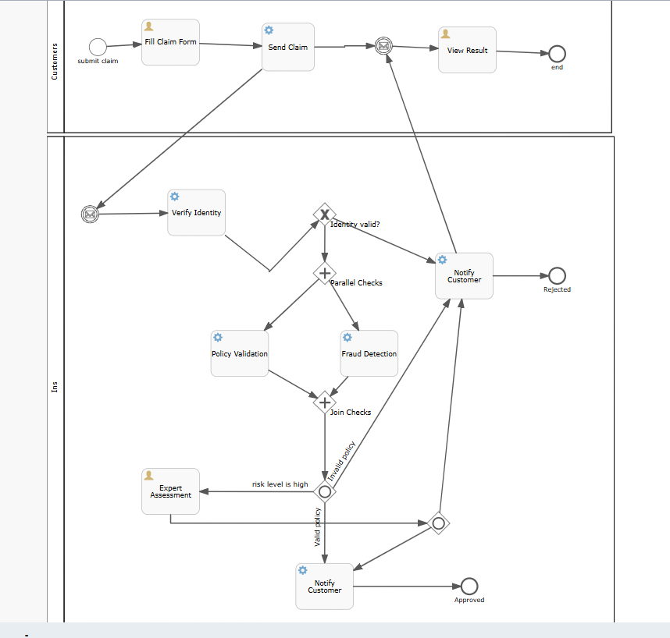
BPMN workflow

Slide 11
Limitations Flowable
BPMN workflow successfully modeled in Flowable
Service invocation limited by runtime deployment constraints
Services implemented and verified independently
Live demo shows service functionality

Slide 12
Live Demo
Thijmen Welberg

Slide 13
Questions?
Thijmen Welberg

Slide 14
Thank you for listening!
Thijmen Welberg

